Slide 1

Summer training Report

Slide 2

Name: MUTEEN MUSHTAQ, ADITYA KHAJURIA Reg No: 12001755,12014057

Slide 3
INTRODUCTION
What is machine learning? Machine learning (ML) is a type of artificial intelligence (AI) that allows software applications to become more accurate at predicting outcomes without being explicitly programmed to do so. Machine learning algorithms use historical data as input to predict new output values. Recommendation engines are a common use case for machine learning. Other popular uses include fraud detection, spam filtering, malware threat detection, business process automation (BPA) and Predictive maintenance. Why is machine learning important? Machine learning is important because it gives enterprises a view of trends in customer behaviour and business operational patterns, as well as supports the development of new products. Many of today's leading companies, such as Facebook, Google and Uber, make machine learning a central part of their operations. Machine learning has become a significant competitive differentiator for many companies.

Slide 4
What are the different types of machine learning?
Classical machine learning is often categorized by how an algorithm learns to become more accurate in its predictions. There are four basic approaches: supervised learning, unsupervised learning, semi-supervised learning and reinforcement learning. The type of algorithm data scientists choose to use depends on what type of data they want to predict.
Supervised learning:
: In this type of machine learning, data scientists supply algorithms with labeled training data and define the variables they want the algorithm to assess for correlations. Both the input and the output of the algorithm is specified.

Slide 5
Unsupervised learning::
In this type of machine learning, data scientists supply algorithms with unlabeled training data and define the variables they want the algorithm to assess for correlations. Both the input and the output of the algorithm is specified.
Semi-supervised learning:
: This approach to machine learning involves a mix of the two preceding types. Data scientists may feed an algorithm mostly labeled training data, but the model is free to explore the data on its own and develop its own understanding of the data set.
Reinforcement learning:
: This approach to machine learning involves a mix of the two preceding types. Data scientists may feed an algorithm mostly labeled training data, but the model is free to explore the data on its own and develop its own understanding of the data set.

Slide 6
Technology Learnt
INTRODUCTION TO MACHINE LEARNING
• Definition of Machine Learning:
Arthur Samuel, an early American leader in the field of computer gaming and artificial intelligence, coined the term “Machine Learning” in 1959 while at IBM. He defined machine learning as “the field of study that gives computers the ability to learn without being explicitly programmed “. However, there is no universally accepted definition for machine learning. Different authors define the term differently. We give below two more definitions. Define an API .
An API (Application Programming Interface) is a collection of packages, a package is the collection of classes, interfaces and sub-packages. A sub-package is a collection of classes interfaces and sub sub packages etc.
• Machine learning is programming computers to optimize a performance criterion using example data or past experience . We have a model defined up to some parameters, and learning is the execution of a computer program to optimize the parameters of the model using the training data or past experience. The model may be predictive to make predictions in the future, or descriptive to gain knowledge from data
• The field of study known as machine learning is concerned with the question of how to construct computer programs that automatically improve with experience

Slide 7

DATA: It can be any unprocessed fact, value, text, sound, or picture that is not being interpreted and analyzed. Data is the most important part of all Data Analytics, Machine Learning, Artificial Intelligence. Without data, we can’t train any model and all modern research and automation will go in vain. Big Enterprises are spending lots of money just to gather as much certain data as possible.
Example: Why did Facebook acquire WhatsApp by paying a huge price of $19 billion? The answer is very simple and logical – it is to have access to the users’ information that Facebook may not have but WhatsApp will have. This information of their users is of paramount importance to Facebook as it will facilitate the task of improvement in their services.
INFORMATION: Data that has been interpreted and manipulated and has now some meaningful inference for the users.
KNOWLEDGE: Combination of inferred information, experiences, learning, and insights. Results in awareness or concept building for an individual or organization. ability to learn. Machine learning is actively being used today, perhaps in many more places than one would expect

Slide 8
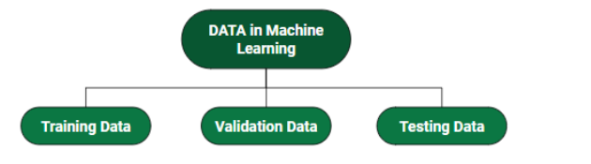
How we split data in Machine Learning?
• Training Data: The part of data we use to train our model. This is the data that your model actually sees(both input and output) and learns from.
• Validation Data: The part of data that is used to do a frequent evaluation of the model, fit on the training dataset along with improving involved hyperparameters (initially set parameters before the model begins learning). This data plays its part when the model is actually training.
• Testing Data: Once our model is completely trained, testing data provides an unbiased evaluation. When we feed in the inputs of Testing data, our model will predict some values(without seeing actual output). After prediction, we evaluate our model by comparing it with the actual output present in the testing data. This is how we evaluate and see how much our model has learned from the experiences feed in as training data, set at the time of training.

Slide 9
Different Forms of Data:
Numeric Data : If a feature represents a characteristic measured in numbers , it is called a numeric feature
Categorical Data : A categorical feature is an attribute that can take on one of the limited , and usually fixed number of possible values on the basis of some qualitative property . A categorical feature is also called a nominal feature.
Ordinal Data : This denotes a nominal variable with categories falling in an ordered list . Examples include clothing sizes such as small, medium , and large , or a measurement of customer satisfaction on a scale from “not at all happy” to “very happy”.
Properties of Data
Volume: Scale of Data. With the growing world population and technology at exposure, huge data is being generated each and every millisecond.
Variety: Different forms of data – healthcare, images, videos, audio clippings.
Velocity: Rate of data streaming and generation.
Value: Meaningfulness of data in terms of information that researchers can infer from it.
5. Veracity: Certainty and correctness in data we are working on

Slide 10
When Regression is chosen?
A regression problem is when the output variable is a real or continuous value, such as “salary” or “weight”. Many different models can be used, the simplest is linear regression. It tries to fit data with the best hyperplane which goes through the points. Regression Analysis is a statistical process for estimating the relationships between the dependent variables or criterion variables and one or more independent variables or predictors. Regression analysis explains the changes in criteria in relation to changes in select predictors. The conditional expectation of the criteria is based on predictors where the average value of the dependent variables is given when the independent variables are changed. Three major uses for regression analysis are determining the strength of predictors, forecasting an effect, and trend forecasting.
Types of Regression:
• Linear regression is used for predictive analysis. Linear regression is a linear approach for modelling the relationship between the criterion or the scalar response and the multiple predictors or explanatory variables. Linear regression focuses on the conditional probability distribution of the response given the values of the predictors. For linear regression, there is a danger of overfitting. The formula for linear regression is: Y’ = bX + A

Slide 11
. Polynomial regression is used for curvilinear data. Polynomial regression is fit with the method of least squares. The goal of regression analysis is to model the expected value of a dependent variable y in regards to the independent variable x. The equation for polynomial regression isY = a + bX
Ridge regression is a technique for analyzing multiple regression data. When multicollinearity occurs, least squares estimates are unbiased. A degree of bias is added to the regression estimates, and as a result, ridge regression reduces the standard errors.
Lasso regression is a regression analysis method that performs both variable selection and regularization. Lasso regression
n uses soft thresholding. Lasso regression selects only a subset of the provided covariates for use in the final model.
ElasticNet regression is a regularized regression method that linearly combines the penalties of the lasso and ridge methods. ElasticNet regression is used for support vector machines, metric learning, and portfolio optimization. The penalty function is given by: . Below is the simple implementation:

Slide 12
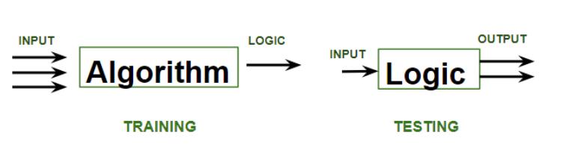
ML | Types of Learning – Supervised Learning
A machine is said to be learning from past Experiences(data feed-in) with respect to some class of tasks if its Performance in a given Task improves with the Experience. For example, assume that a machine has to predict whether a customer will buy a specific product let’s say “Antivirus” this year or not. The machine will do it by looking at the previous knowledge/past experiences i.e the data of products that the customer had bought every year and if he buys Antivirus every year, then there is a high probability that the customer is going to buy an antivirus this year as well. This is how machine learning works at the basic conceptual level.

Slide 13
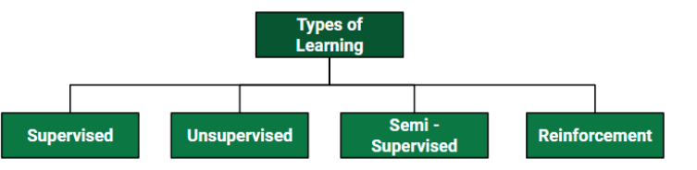
Supervised learning
is when the model is getting trained on a labelled dataset. A labelled dataset is one that has both input and output parameters. In this type of learning both training and validation, datasets are labelled as shown in the figures below.

Slide 14
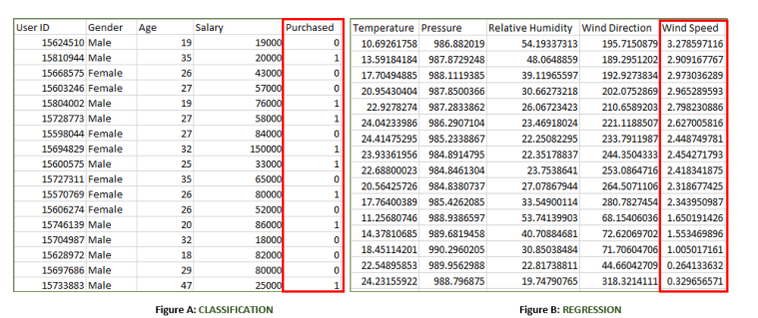
Both the above figures have labelled data set as follows:
• Figure A: It is a dataset of a shopping store that is useful in predicting whether a customer will purchase a particular product under consideration or not based on his/ her gender, age, and salary. Input: Gender, Age, Salary Output: Purchased i.e. 0 or 1; 1 means yes the customer will purchase and 0 means that the customer won’t purchase it
. • Figure B: It is a Meteorological dataset that serves the purpose of predicting wind speed based on different parameters. Input: Dew Point, Temperature, Pressure, Relative Humidity, Wind Direction Output: Wind Speed

Slide 15
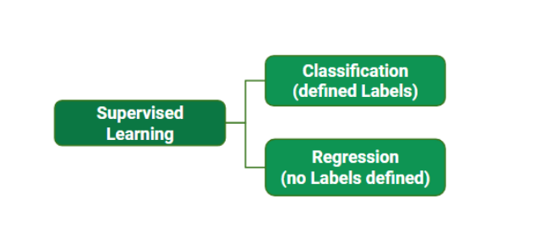
Training the system: While training the model, data is usually split in the ratio of 80:20 i.e. 80% as training data and the rest as testing data. In training data, we feed input as well as output for 80% of data. The model learns from training data only. We use different machine learning algorithms(which we will discuss in detail in the next articles) to build our model. Learning means that the model will build some logic of its own. Once the model is ready then it is good to be tested. At the time of testing, the input is fed from the remaining 20% of data that the model has never seen before, the model will predict some value and we will compare it with the actual output and calculate the accuracy.

Slide 16
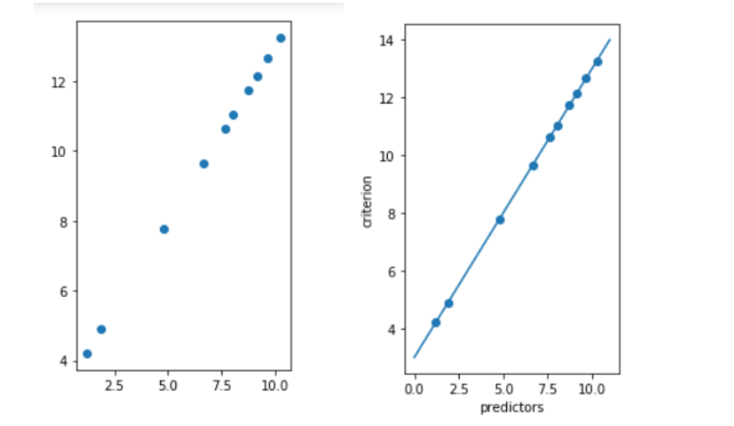
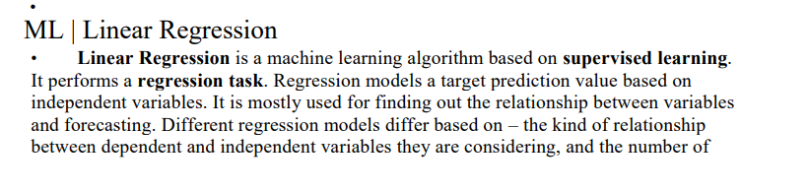

Slide 17
Clustering in Machine Learning Introduction to Clustering:It is basically a type of unsupervised learning method. An unsupervised learning method is a method in which we draw references from datasets consisting of input data without labeled responses. Generally, it is used as a process to find meaningful structure, explanatory underlying processes, generative features, and groupings inherent in a set of examples. Clustering is the task of dividing the population or data points into a number of groups such that data points in the same groups are more similar to other data points in the same group and dissimilar to the data points in other groups. It is basically a collection of objects on the basis of similarity and dissimilarity between them.

Slide 18
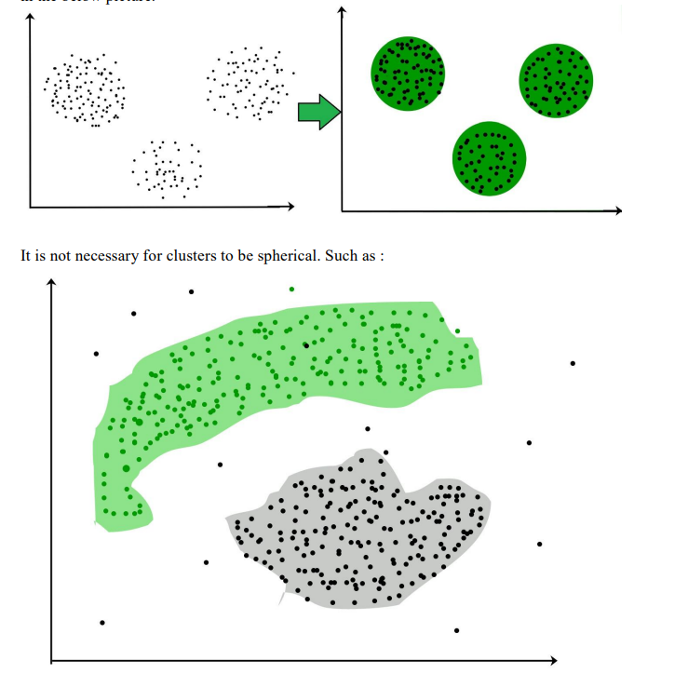

Slide 19
CONCLUSION
Practical knowledge means the visualization of the knowledge, which we read in our books. For this, we perform experiments and get observations. Practical knowledge is very important in every field. One must be familiar with the problems related to that field so that he may solve them and become a successful person. After achieving the proper goal in life, an engineer has to enter in professional life. According to this life, he has to serve an industry, may be public or private sector or self own. For the efficient work in the field, he must be well aware of the practical knowledge as well as theoretical knowledge.
Due to all above reasons and to bridge the gap between theory and practical, our Engineering curriculum provides a practical training of 45 days. During this period a student work in the industry and get well all type of experience and knowledge about the working of companies and hardware and software tools.
I have undergone my 45 days summer training in 5th sem at SIMPLILEARN. This report is based on the knowledge, which I acquired during my 45 days of summer training

Slide 20


